Slide 1
Why do you need version control?
By Shahbaz Chaudhary

Slide 2
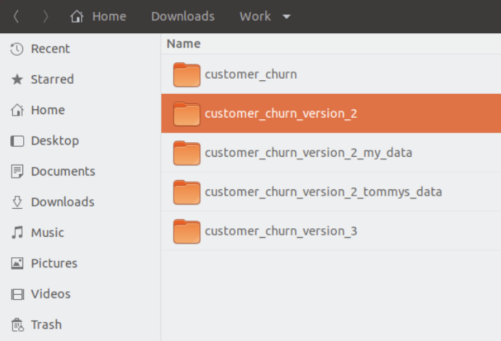
1. Version control remembers history
Version control remembers every change you make to your project.
You can make comments about the reason you changed something.
You can go back in time to any change.
You can even have multiple timelines – people working on different versions of code.
All in a single directory

Slide 3
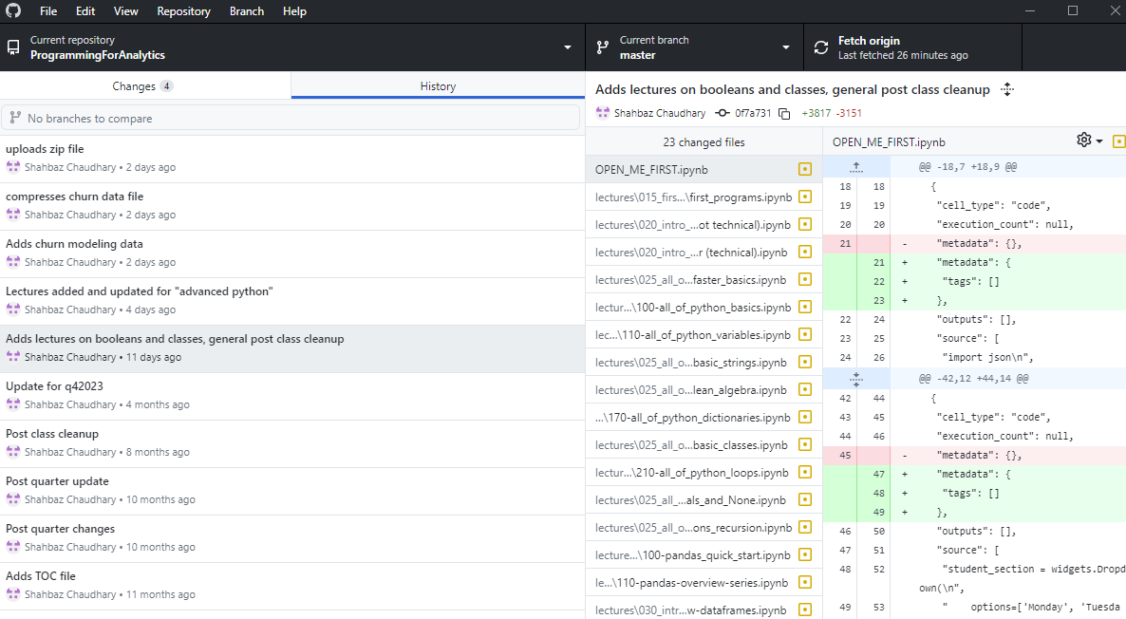
1. Version control remembers history

Slide 4
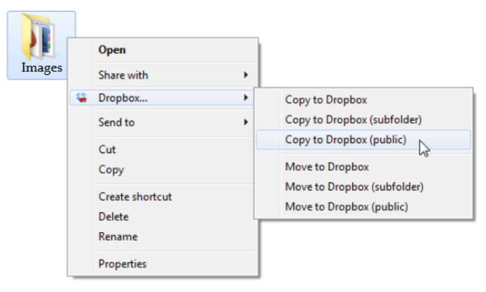
2. A remote repository can serve as a backup
You can replicate the full history of your version-controlled repository to a remote server. Your collaborators can pull this repository, along with its full history.

Slide 5
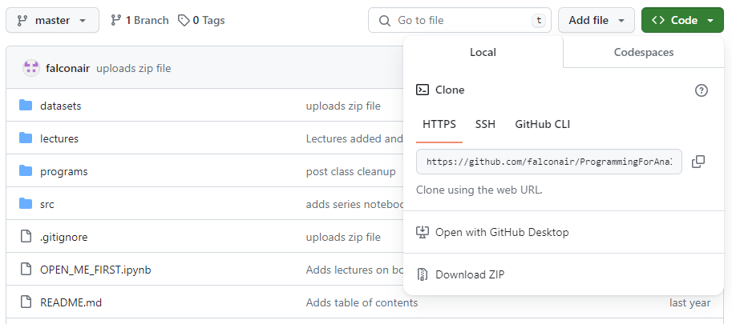
2. A remote repository can serve as a backup

Slide 6
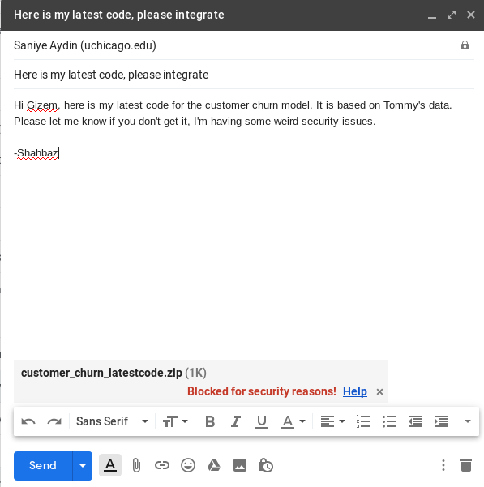
3. A web-based service can make collaboration easier
Modern repository services, such as GitHub and BitBucket make it very easy to collaborate.
Linus Torvalds actually created git for internet scale collaboration for the Linux kernel (story time).
These services further provide space for task management and other services

Slide 7
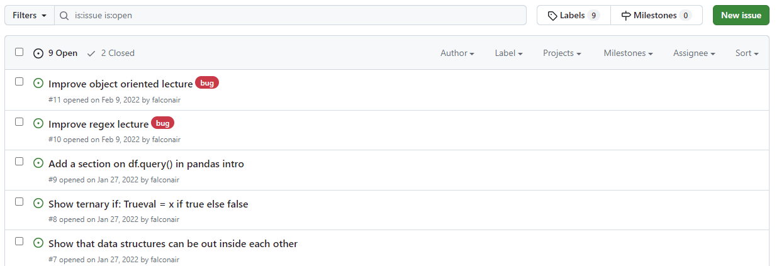
3. A web-based service can make collaboration easier

Slide 8
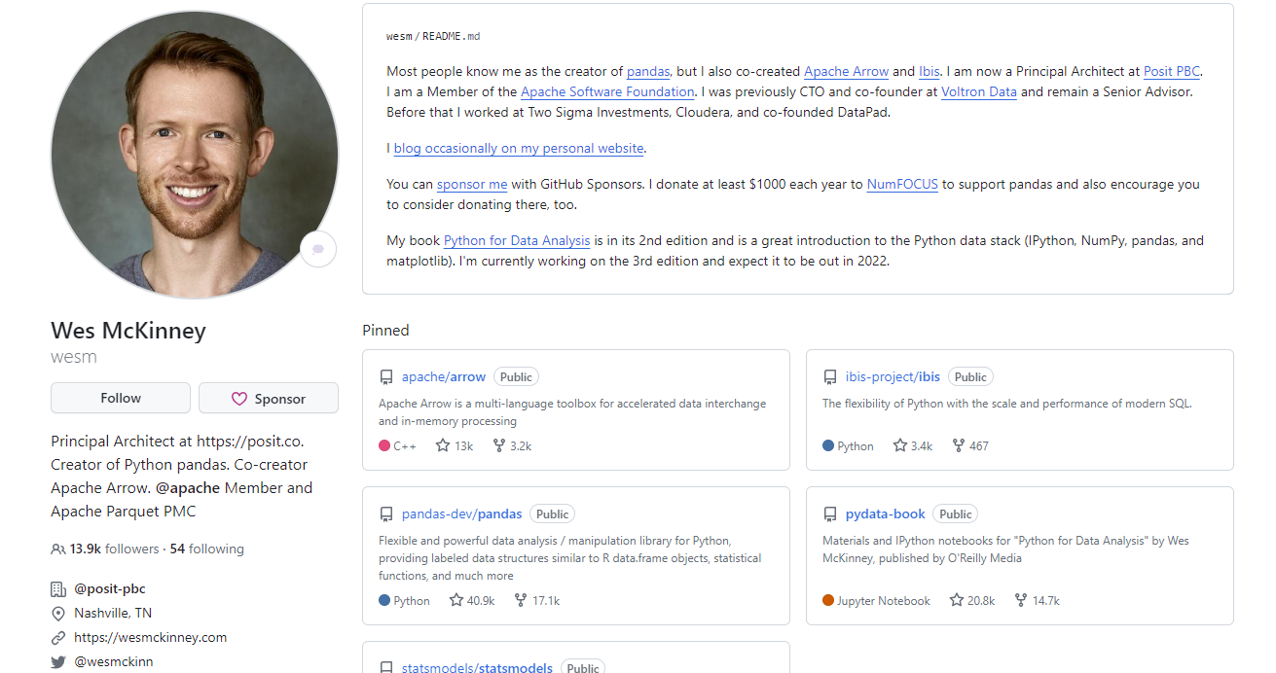
4. GitHub is also the modern resume (along with Linked-In)
Employers often ask for a public GitHub link to see actual code examples.
Use it to showcase class projects, side-gigs, even little blurbs about yourself.
But DON’T misrepresent your work! I have personally found examples of copied code!

Slide 9
Hands on keyboard …

Slide 10
Install Git https://git-scm.com/downloads
Some nice GUIs cataloged at: https://git-scm.com/downloads/guis
GitHub has a very minimal GUI (seen earlier): https://desktop.github.com/
Jupyter Lab has a well integrated Git extension: https://github.com/jupyterlab/jupyterlab-git
VS Code has a built-in Git extension

Slide 11
git clone
“Download” a remote repository

Slide 12
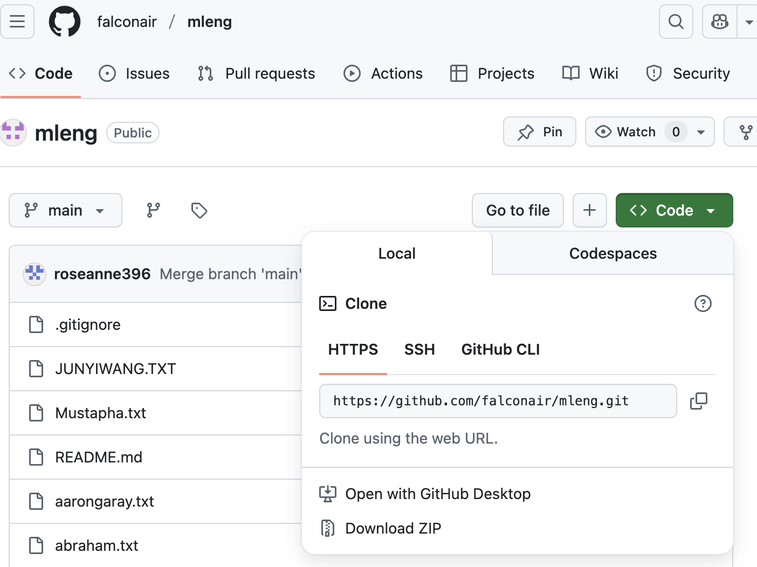
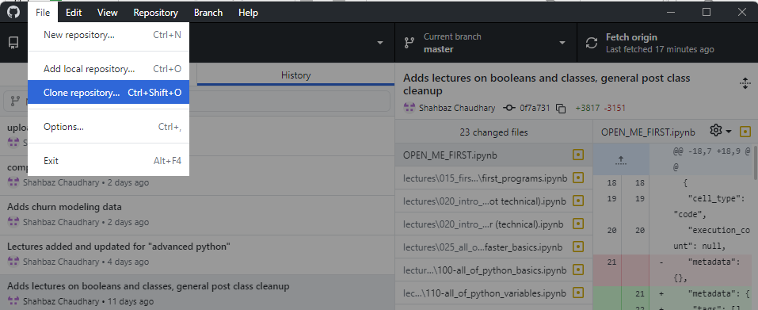
Clone a repository https://github.com/falconair/mleng_class
Click “Clone”
Using GitHub Desktop
Using the command line
git clone https://github.com/falconair/mleng_class.git

Slide 13
git pull
Bring changes from remote server to your machine

Slide 14
Get latest changes with git pull
Me
git clone
git push
git push
Git Server
New repo
git clone
git pull
git pull
You

Slide 15
git add git commit –m “message” git push
Tell git to start tracking a file or a change, make it part of history, send to server

Slide 16
Record your change with git add -> git commit -> git push
Me
git pull
git pull
Git Server
git push
git push
You
git add
git commit – “New file …”
git add
git commit – “Removes typo from …”
New file
Update file
Tip:
Use git status to check the status
Use git diff to compare uncommitted changes

Slide 17
git branch git checkout –b branch_name
Create a branch to isolate work

Slide 18
Compartmentalize your work
Git Server
git push
main
git branch feature123
git switch feature123
New file
git switch feature123
git merge feature123
git add
git commit ..
git switch main
git switch main
feature123
Get changes from remote server |  | git pull
Tell git to start tracking this file |  | git add
Tell git to record the change |  | git commit –m “message”
List all branches |  | git branch
Switch to a different branch |  | git switch branch_name
… create it if it doesn’t exist |  | git switch –c branch_name
Bring changes into the current branch |  | git merge branch_name

Slide 19
Compartmentalize your work
Git Server
git push
main
git branch feature123
git switch feature123
New file
git switch feature123
git merge feature123
git add
git commit ..
git switch main
git checkout main
feature123
1. Create new branch feature1
2. Switch to it
3. Switch back to main
4. Switch to feature1
5. Create new file
It exists in both branches since it
isn’t tracked by git
6. Add and commit
It only exists in feature1
List all branches |  | git branch
Switch to a different branch |  | git switch branch_name
… create it if it doesn’t exist |  | git switch –c branch_name
Bring changes into the current branch |  | git merge branch_name

Slide 20
git merge
What if conflicting changes are made to the same file?

Slide 21

What if changes conflict?
test
main
git add
git commit ..
main
git branch conflict
git switch conflict
New file
test.txt
git merge conflict
New file
test.txt
Same file, conflicting edits!
feature123
git switch main
git add
git commit ..
1. Create new branch conflict
2. Switch to it
3. Create file test.txt with “test”
4. Add and commit
5. Switch back to main
6. Create file test.txt with “main”
7. Add and commit
8. git merge conflict
9. Use git diff to see the difference
10. Need to resolve the conflict!
List all branches |  | git branch
Switch to a different branch |  | git switch branch_name
… create it if it doesn’t exist |  | git switch –c branch_name
Bring changes into the current branch |  | git merge branch_name

Slide 22

…or just overwrite the local file

Slide 23
git add?
Actually, there is another layer, called stage

Slide 24
Introducing the “stage” layer
Git Server
main
stage
Create new file
or make a change
git add file
Make more edits
git add file
git commit –m “adds two files”
git push

Slide 25
Git’s pull is actually fetch + merge
Git Server
stage
main
git pull
git fetch
git fetch
git merge
Make more edits

Slide 26
git branch
Keep clean development histories

Slide 27
The story so far: git clone|pull|diff
Download repository to your laptop: git clone
Get latest changes: git pull
Merge conflicts happen when there are conflicting changes in a file. The git diff command can give more details, but most of us should switch to GUI tools to resolve conflicts.
Resolving a merge conflict, although scary sounding, just means that a human needs to decide which changes to keep.

Slide 28

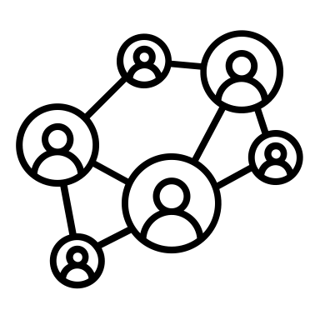

Git is a distributed version control system
When you clone a repository, you are pulling down all the files and their history.
You then operate only on the local copy. If you want to sync the changes, you have to explicitly push the changes back.
Git operates as a giant network of peers, not as a remote/local hierarchy

Slide 29
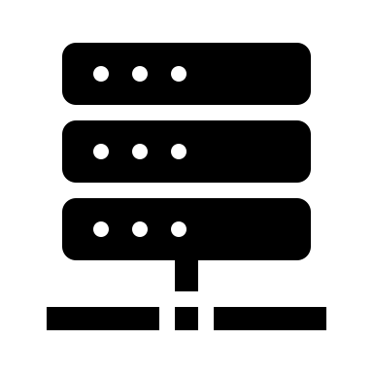

Recap: clone, pull, diff, commit, push
git clone <repo>
Downloads the repo to laptop

Slide 30
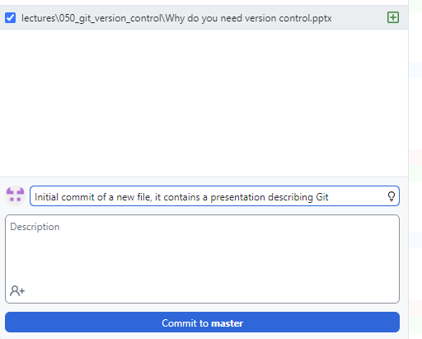
Create a repo, git commit and git push to it
So far, we have had only one way interactions with repositories. Now we need to go the other way.
Create an account on GitHub (pick your name wisely, it will be your internet identity)
Create a new repository
Clone it
Add a new file to it
How has the status changed?
1. “Commit” file to version control
2. “Push” file to remote repository

Slide 31
For a future episode…

Slide 32
More commands
git commit –m “fixed bug #123”
git push
git reset
git branch
git …

Slide 33
Appendix

Slide 34
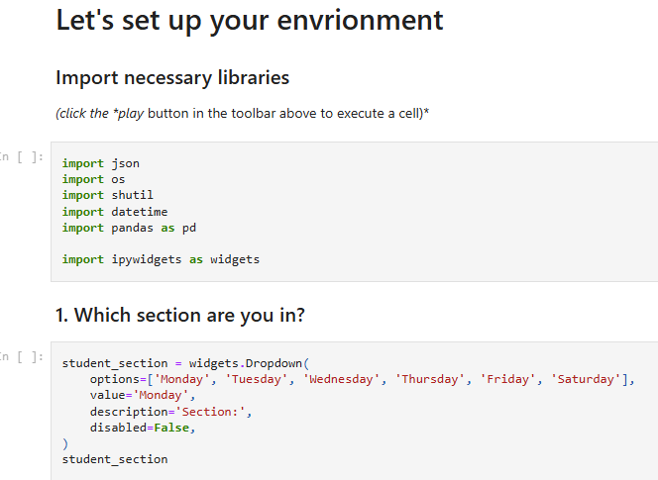
Reminder: Jupyter notebooks are just JSON
{
"cells": [
{
"cell_type": "markdown",
"metadata": {},
"source": [
"# Let's set up your envrionment"
]
},
{
"cell_type": "markdown",
"metadata": {},
"source": [
"### Import necessary libraries \n",
"*(click the *play* button in the toolbar above to execute a cell)*"
]
},

